Slide 1
The Nature of Light
Before the beginning of the nineteenth century, light was considered to be a stream of particles
The particles were either emitted by the object being viewed or emanated from the eyes of the viewer
Newton was the chief architect of the particle theory of light
He believed the particles left the object and stimulated the sense of sight upon entering the eyes

Slide 2
Nature of Light – Alternative View
Christian Huygens argued that light might be some sort of a wave motion

Slide 3
Young’s Contribution
Thomas Young (1801) provided the first clear demonstration of the wave nature of light
He showed that light rays interfere with each other
Such behavior could not be explained by particles

Slide 4
Modern Scriptural Comments on Nature of Light
In September of 1832 Joseph Smith received a revelation that said in part :
For the word of the Lord is truth, and whatsoever is truth is light, and whatsoever is light is Spirit, even the Spirit of Jesus Christ. And the Spirit giveth light to every man that cometh into the world; and the Spirit enlighteneth every man through the world, that hearkeneth to the voice of the Spirit. (D&C 84:45-46)

Slide 5
Modern Scriptural Comments on Nature of Light
In December of 1832 Joseph Smith received another revelation that says in part:
This Comforter is the promise which I give unto you of eternal life, even the glory of the celestial kingdom; which glory is that of the church of the Firstborn, even of God, the holiest of all, through Jesus Christ his Son---He that ascended up on high, as also he descended below all things, in that he comprehended all things, that he might be in all and through all things, the light of truth; which truth shineth. This is the light of Christ. As also he is in the sun, and the light of the sun, and the power thereof by which it was made. As also he is in the moon, and is the light of the moon, and the power thereof by which it was made; as also the light of the stars, and the power thereof by which they were made; and the earth also, and the power thereof, even the earth upon which you astand. And the light which shineth, which giveth you light, is through him who enlighteneth your eyes, which is the same light that quickeneth your understandings; which light proceedeth forth from the presence of God to fill the immensity of space---the light which is in all things, which giveth life to all things, which is the law by which all things are governed, even the power of God who sitteth upon his throne, who is in the bosom of eternity, who is in the midst of all things. (D&C 88:5-12 emphasis added)

Slide 6
More Confirmation of Wave Nature
During the nineteenth century, other developments led to the general acceptance of the wave theory of light
Maxwell asserted that light was a form of high-frequency electromagnetic wave
Hertz confirmed Maxwell’s predictions

Slide 7
Particle Nature
Some experiments could not be explained by the wave nature of light
The photoelectric effect was a major phenomenon not explained by waves
When light strikes a metal surface, electrons are sometimes ejected from the surface
The kinetic energy of the ejected electron is independent of the frequency of the light

Slide 8
e
e
e
e
Big Battery

Slide 9
zzzzzzzzzzzzzzzzzzzzzzzz
Electron
Nucleus with protons and neutrons
Electron
Particles not drawn to scale

Slide 10
Outgoing Electron
Incoming photon
Particles not drawn to scale

Slide 11
Particle Nature, cont.
Einstein (in 1905) proposed an explanation of the photoelectric effect that used the idea of quantization
The quantization model assumes that the energy of a light wave is present in particles called photons
E = hƒ
h is Planck’s Constant and = 6.63 x 10⁻³⁴ J.s

Slide 12
Dual Nature of Light
In view of these developments, light must be regarded as having a dual nature
Light exhibits the characteristics of a wave in some situations and the characteristics of a particle in other situations
Nature prevents testing both qualities at the same time

Slide 13
Question 223.10.1
Light is a …
Electromagnetic Wave
Particle
Neither
Both

Slide 14
Question 223.10.2
The energy of a photon is proportional to
The wavelength
The period
The frequency
π

Slide 15
Measurement of the Speed of Light

Slide 16
Question 223.10.3
The speed of light is always constant
True
False

Slide 17
Question 223.10.4
Can anything go faster than light?
Yes
No
Maybe

Slide 18
Measurements of the Speed of Light
Since light travels at a very high speed, early attempts to measure its speed were unsuccessful
Remember c = 3.00 x 10⁸ m/s
Galileo tried by using two observers separated by about 10 km
The reaction time of the observers was more than the transit time of the light

Slide 19
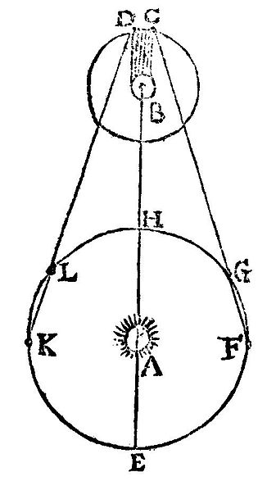
Measurement of the Speed of Light – Roemer’s Method
Ole Roemer (1675) used astronomical observations to estimate the speed of light
He used the period of revolution of Io, a moon of Jupiter, as Jupiter revolved around the sun
In the diagram illustrating Rømer's determination of the speed of light. A: The Sun B: Jupiter C: immersion of Io into Jupiter's shadow at the start of an eclipse D: emergence of Io from Jupiter's shadow at the end of an eclipse E–H, K, L: positions of Earth at different dates (illustrative) E: point of conjunction H: point of opposition

Slide 20
Roemer’s Method, cont.
The periods of revolution were longer when the Earth was receding from Jupiter
and shorter when the Earth was approaching
Using Roemer’s data, Huygens estimated the lower limit of the speed of light to be 2.3 x 10⁸ m/s
This was important because it demonstrated that light has a finite speed as well as giving an estimate of that speed

Slide 21
Measurements of the Speed of Light – Fizeau’s Method
This was the first successful method for measuring the speed of light by means of a purely terrestrial technique
It was developed in 1849 by Armand Fizeau
He used a rotating toothed wheel
The distance between the wheel (considered to be the source) and a mirror was known

Slide 22
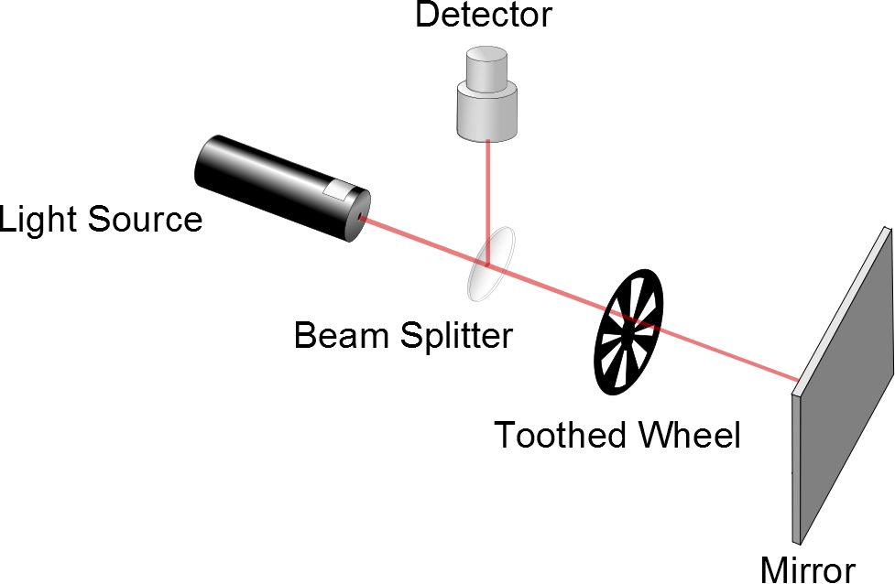
Fizeau’s Method, cont.
d is the distance between the wheel and the mirror
Δt is the time for one round trip
Then c = 2d / Δ t
Fizeau found a value of
c = 3.1 x 10⁸ m/s
Movie

Slide 23
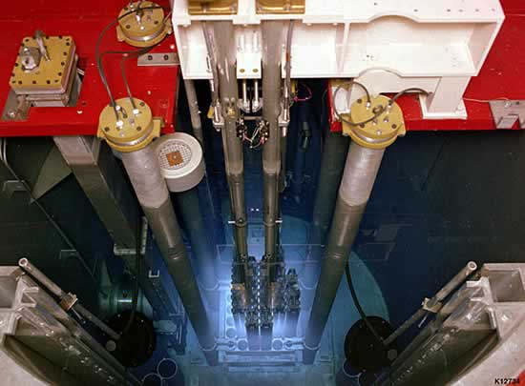
Faster than light?

Slide 24
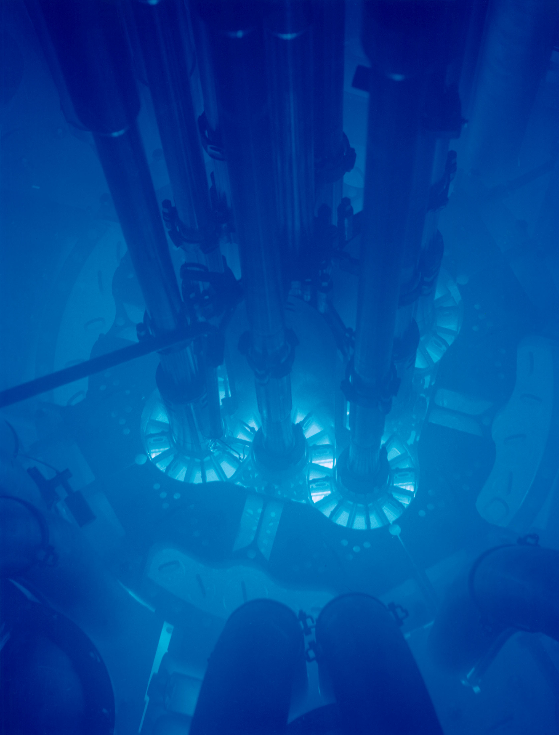

Slide 25
Question
I have an LED emitting light. What shape is the wavefront leaving the tiny LED?
Linear points
Planer surfaces
Spherical surfaces
Cubical surfaces
Hexagonal surfaces

Slide 26
Question
I have an LED emitting light. IT makes a spherical wave front. But if I look at just one tiny point on the spere, what do the wave crests look like?
Linear points
Planer surfaces
Spherical surfaces
Cubical surfaces
Hexagonal surfaces
Just look here

Slide 27
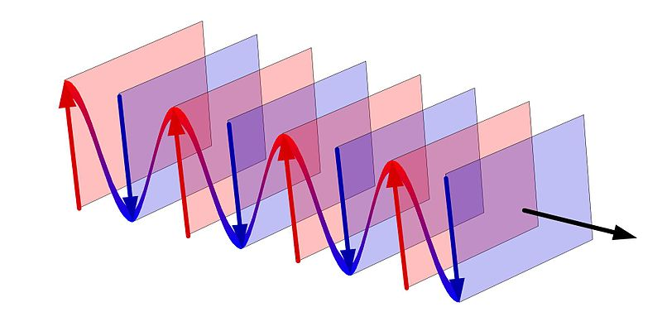

Slide 28
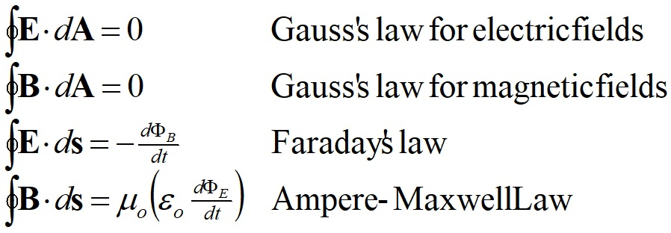

Slide 29
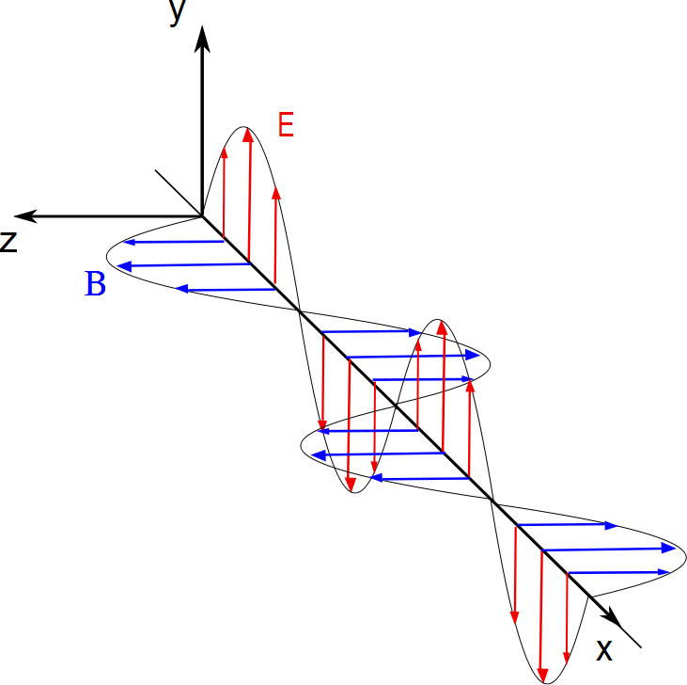
Electric and magnetic field measured along this line
Light Source

Slide 31
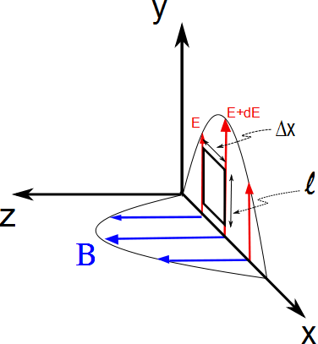

Slide 32
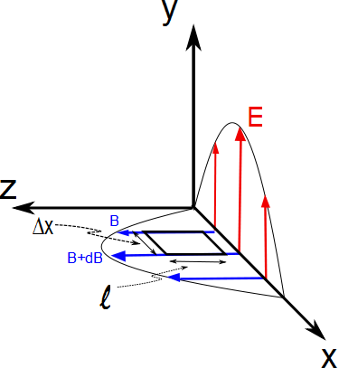

Slide 33
END

Slide 34
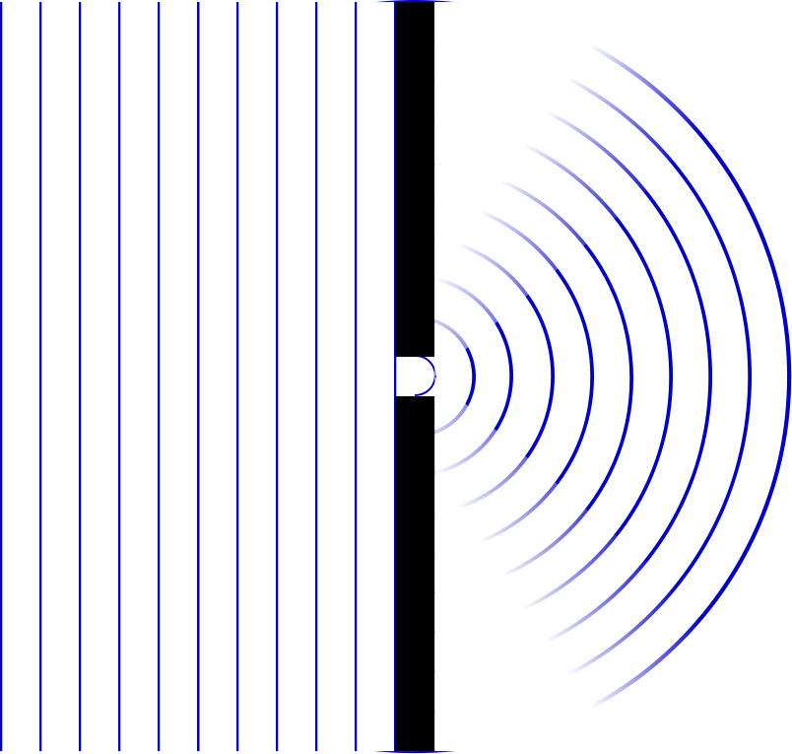

Slide 35
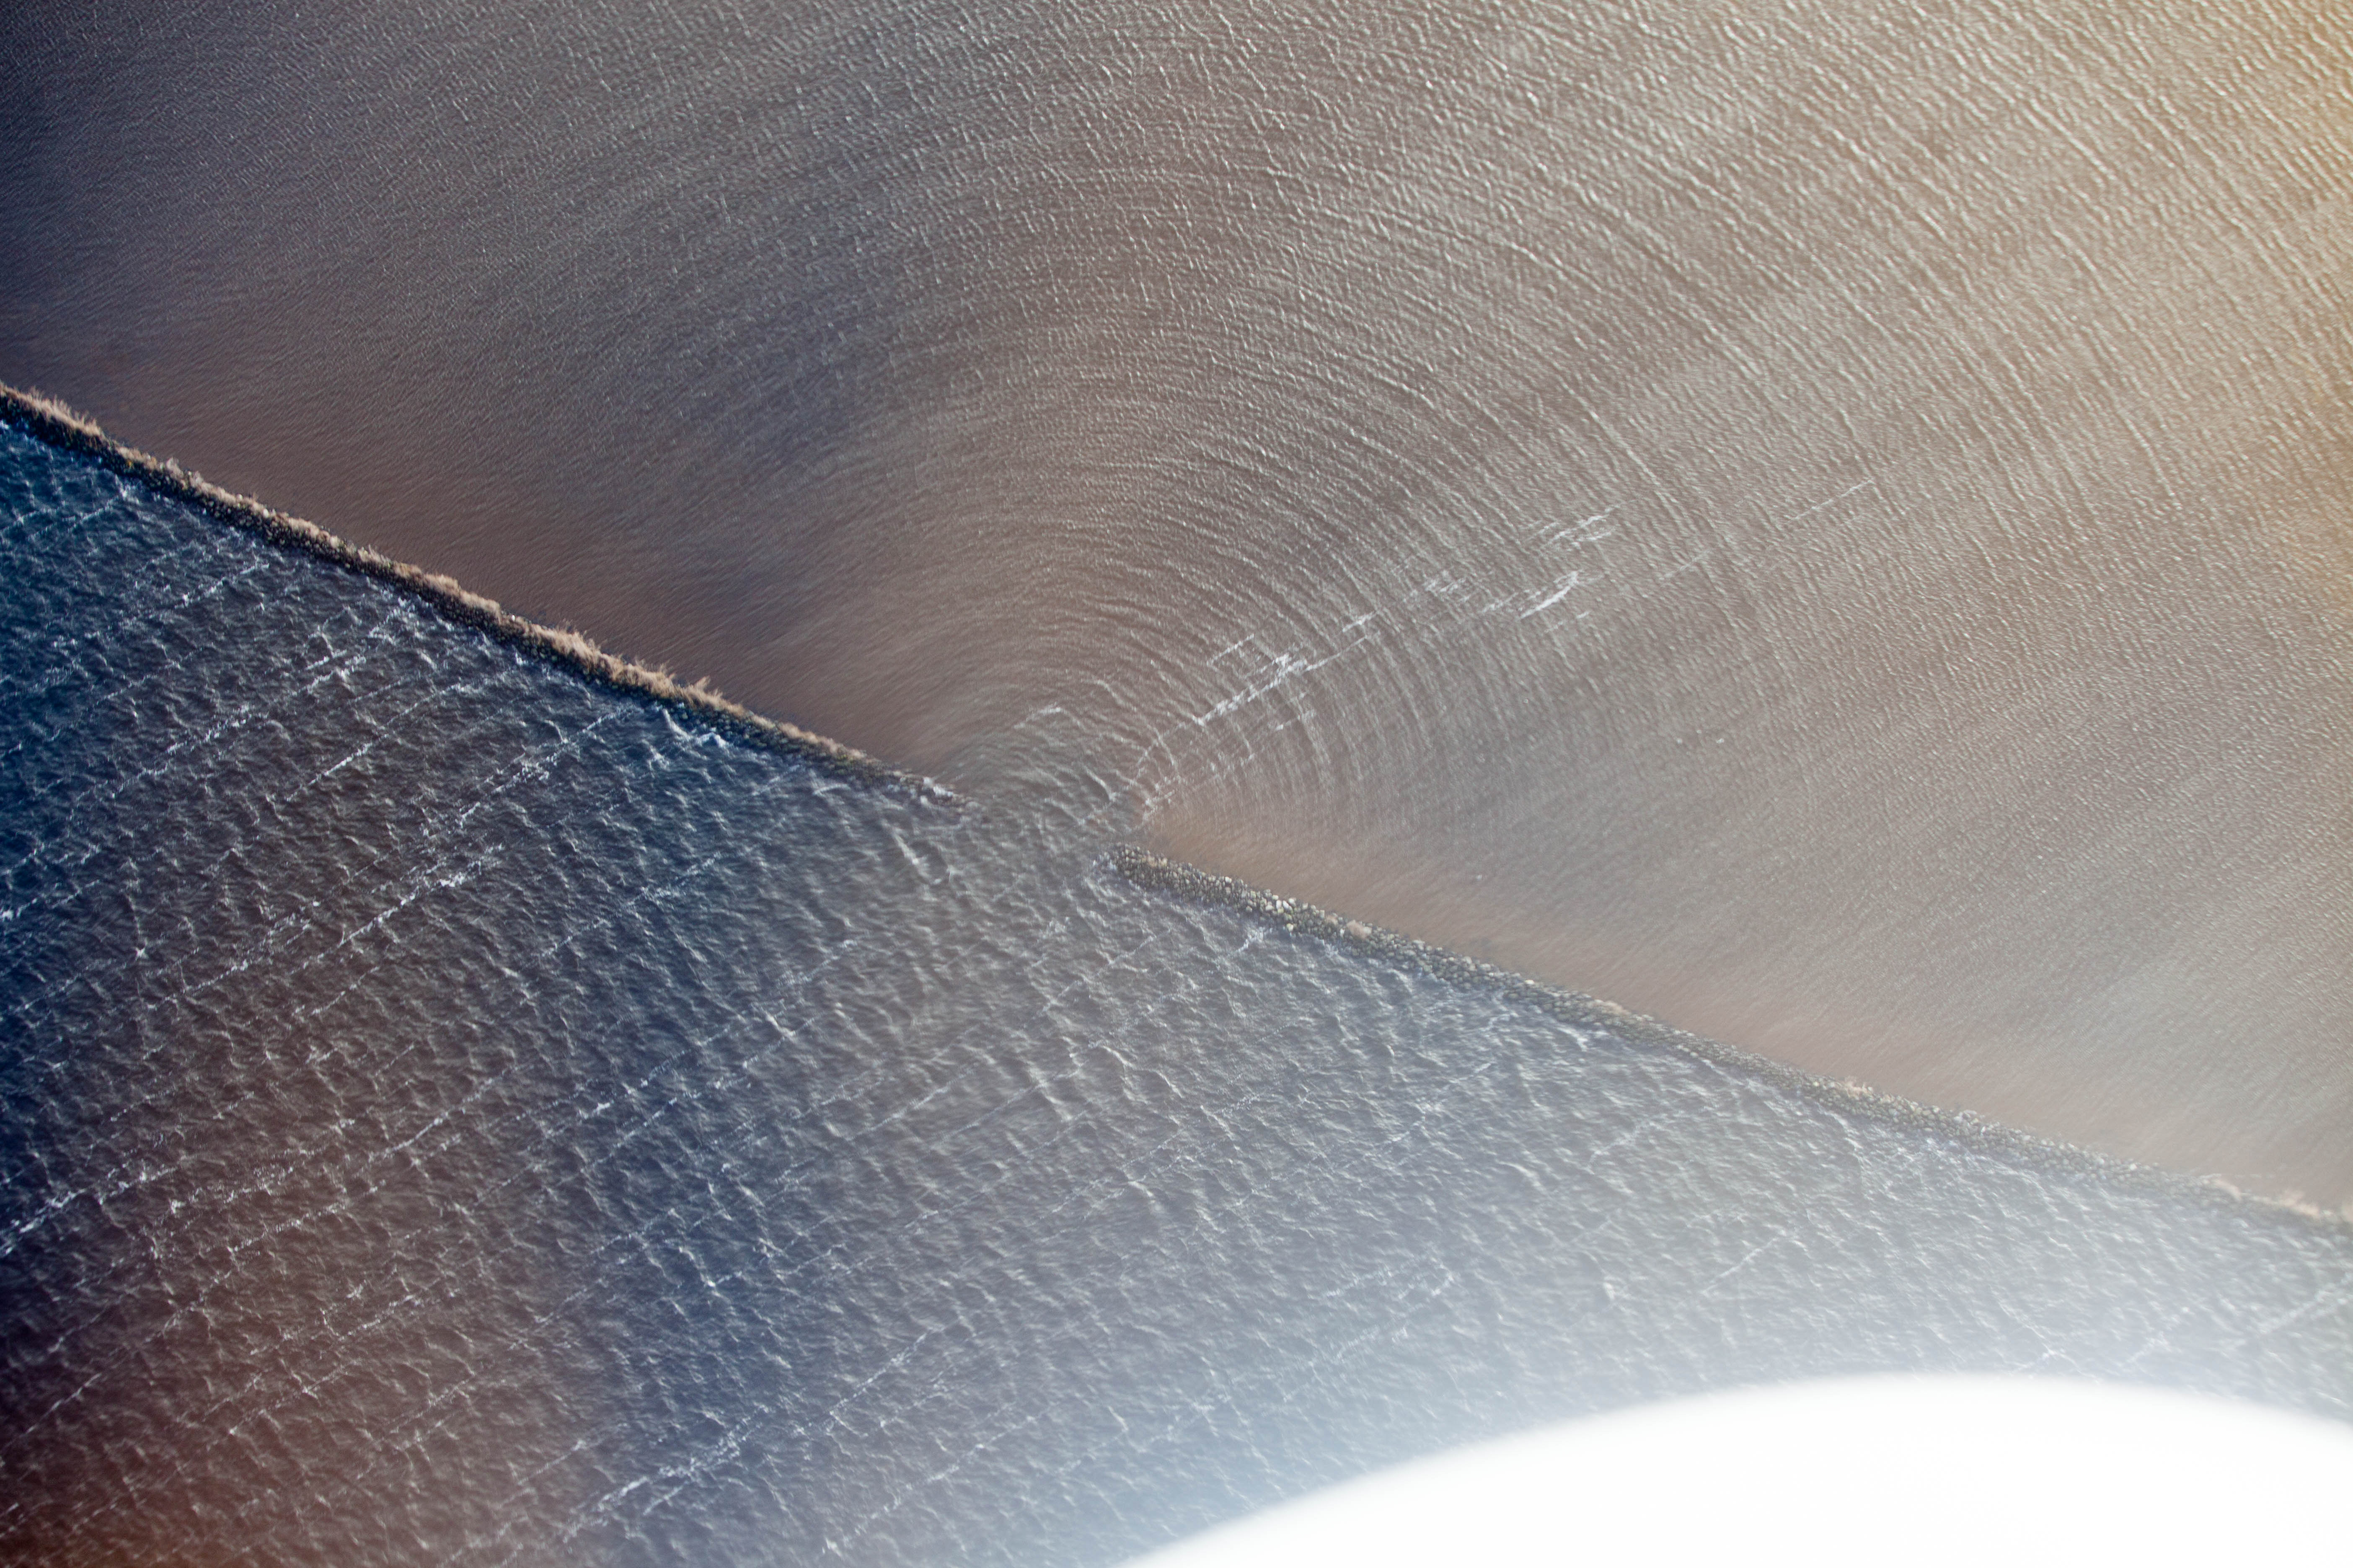
Jeroen Komen from Utrecht, Netherlands
https://commons.wikimedia.org/wiki/File:Waves_changing_direction_through_a_narrow_opening_(20243395322).jpg

Slide 36
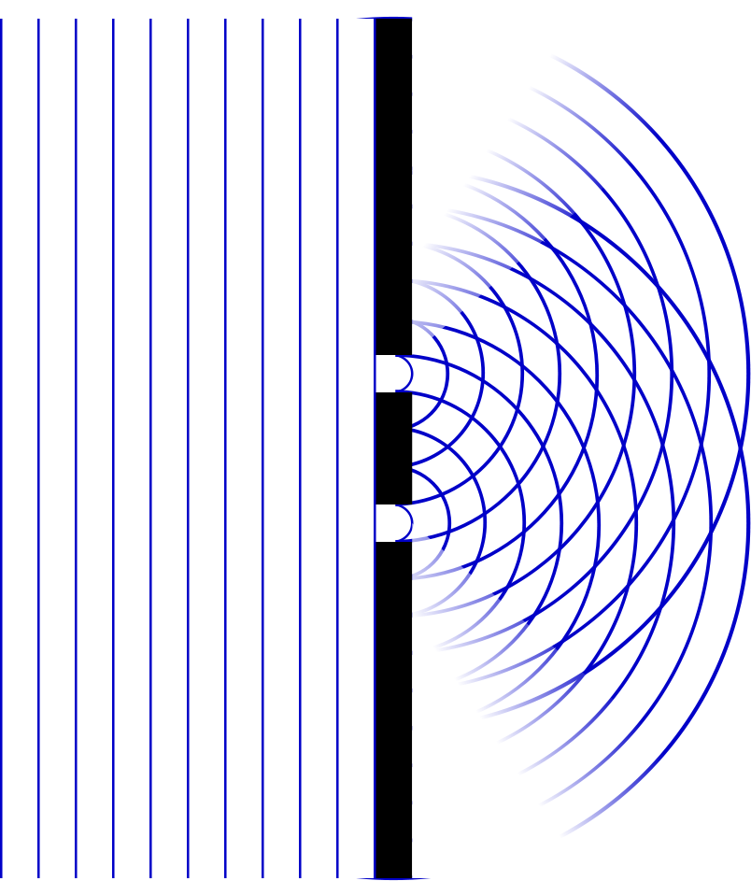

Slide 37
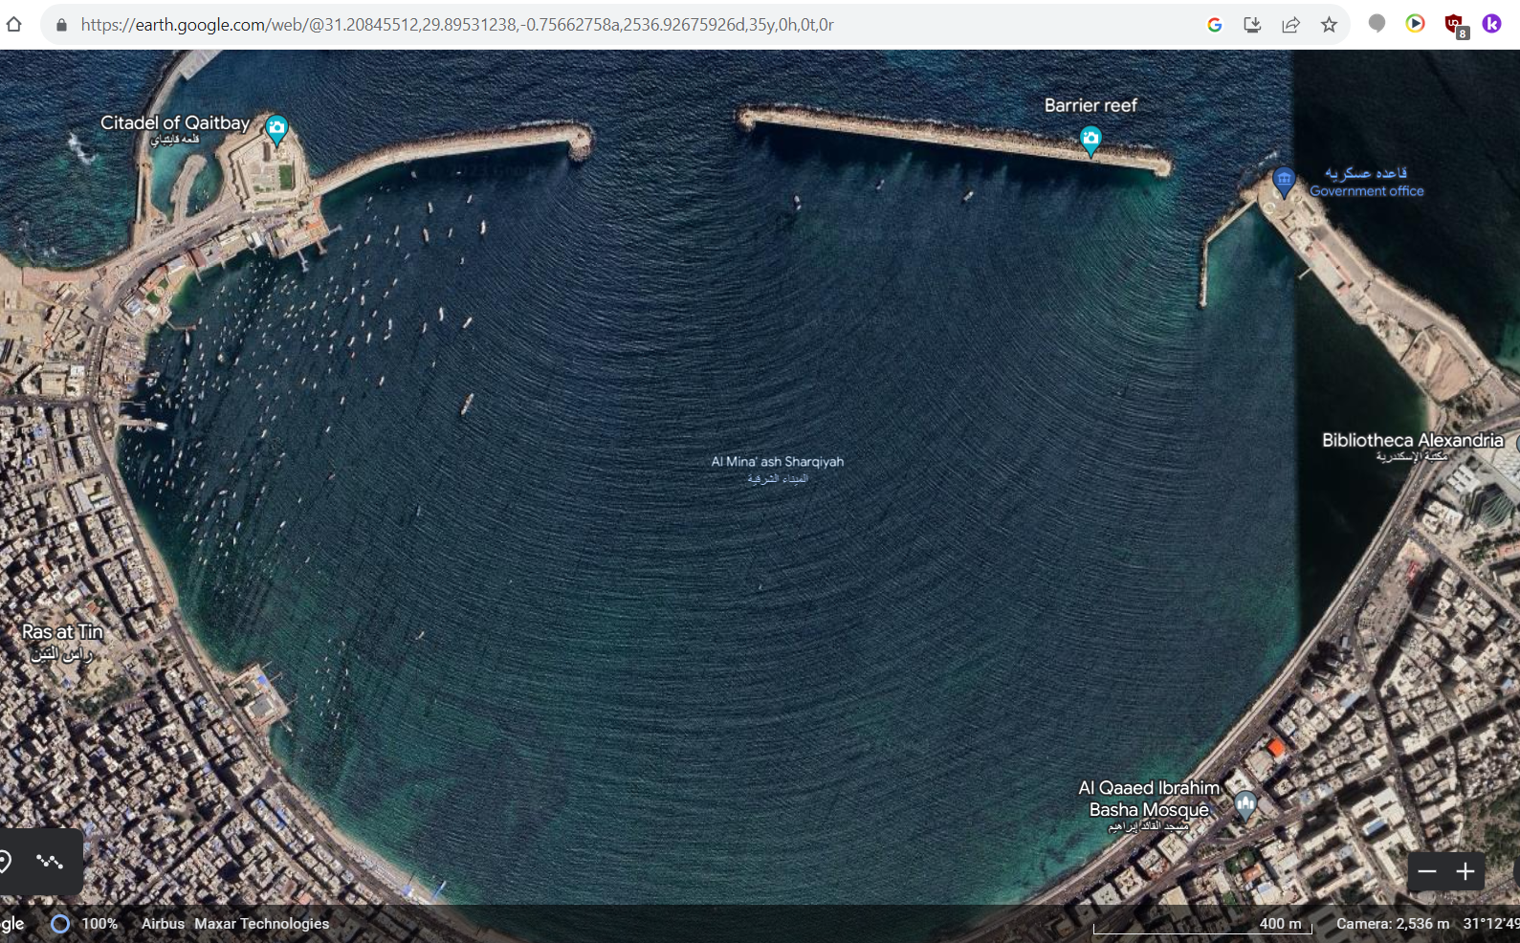

Slide 38
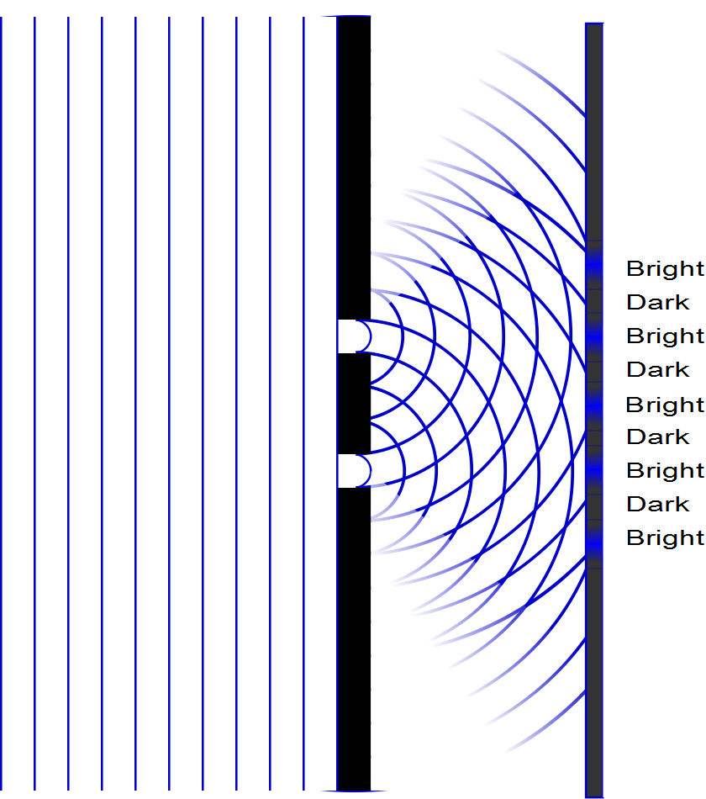

Slide 39
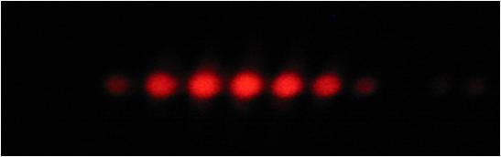

Slide 40
Question 223.10.5
If you see a bright fringe in a “Young’s Experiment,” the path difference from the fringe to the slits must be equal to
And integer number of wavelengths
And integer number of half wavelengths
π
Arctan(θ)

Slide 41
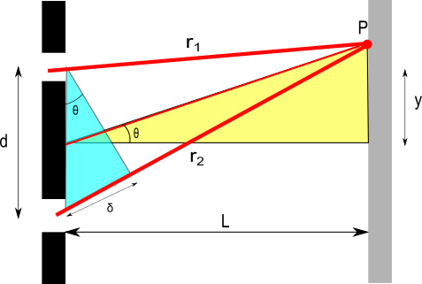
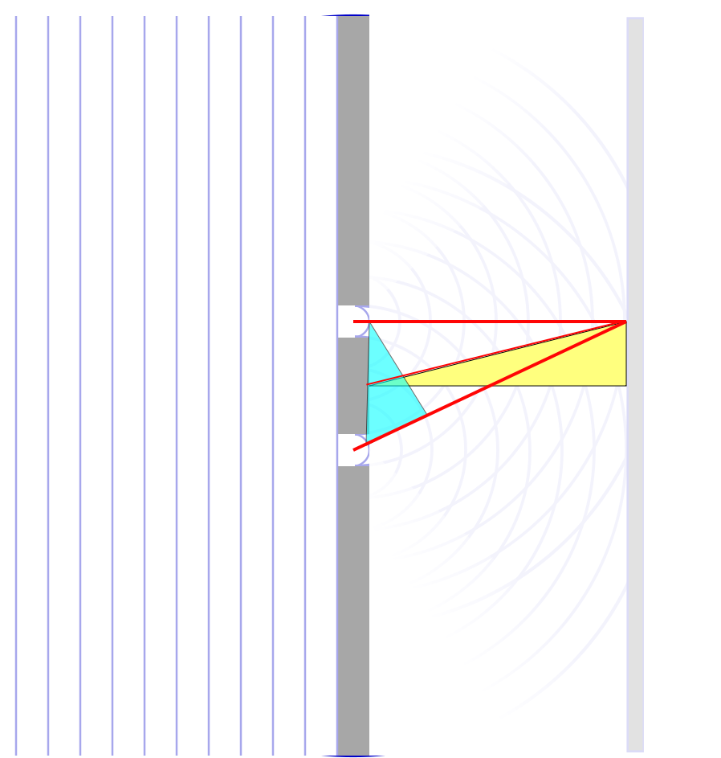

Slide 43
Question 223.10.6
When considering order numbers, m, the possible orders are
1, 2, 3, . . .
0, 1, 2, 3, . . .
0, ±1, ± 2, ± 3, . . .
±1, ± 2, ± 3, . . .

Slide 44
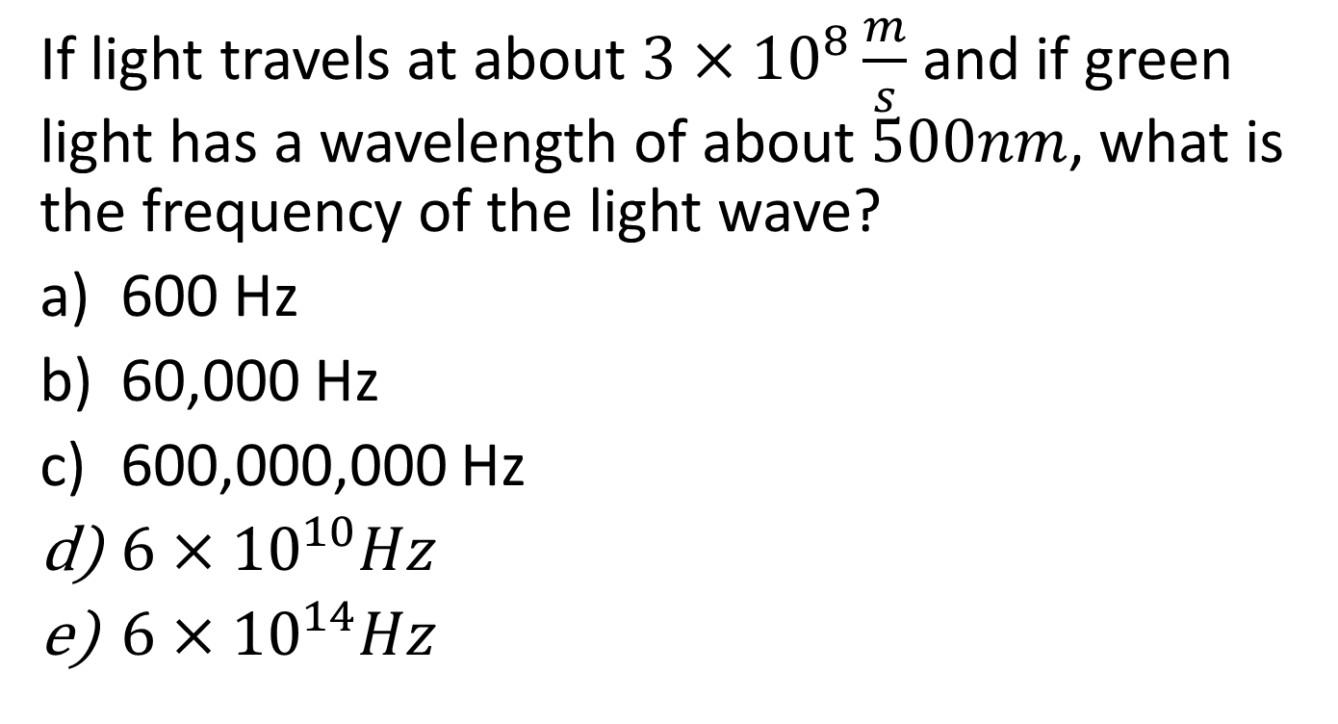
Question
If light travels at about $3×{10}^{8}\frac{m}{s}$ and if green light has a wavelength of about $500nm$, what is the frequency of the light wave?
600 Hz
60,000 Hz
600,000,000 Hz
$6×{10}^{10}Hz$
$6×{10}^{14}Hz$

Slide 45
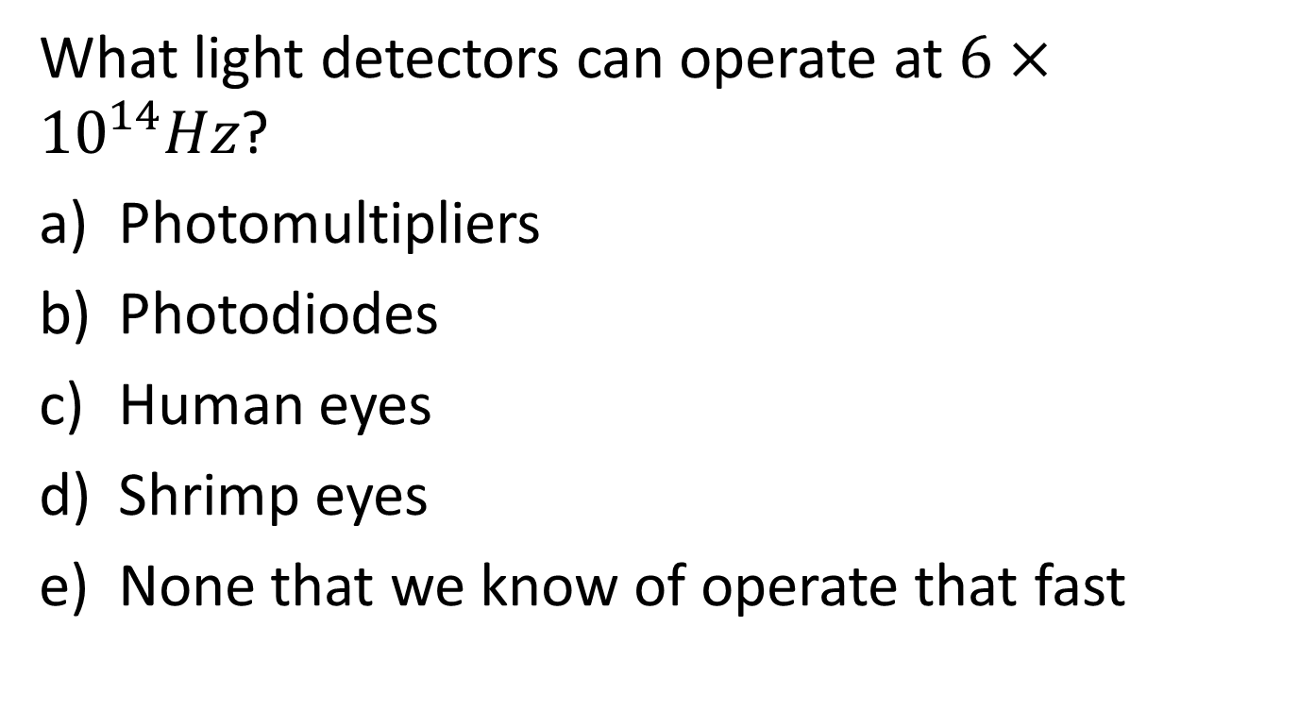
Question
What light detectors can operate at $6×{10}^{14}Hz$?
Photomultipliers
Photodiodes
Human eyes
Shrimp eyes
None that we know of operate that fast

Slide 49
I
Interference fringes:
due to having two slits.
φ/2
-5π
-3π
-π
π
3π
5π

Slide 50
ConcepTest 24.3a Double Slits I
In a double-slit experiment, when the wavelength of the light is increased, the interference pattern
spreads out
stays the same
shrinks together
disappears

Slide 51
ConcepTest 24.3a Double Slits I
In a double-slit experiment, when the wavelength of the light is increased, the interference pattern
spreads out
stays the same
shrinks together
disappears
d sin θ = m λ
If λ is increased and d does not change, then θ must increase, so the pattern spreads out.

Slide 52
ConcepTest 24.3b Double Slits II
If instead the slits are moved farther apart (without changing the wavelength) the interference pattern
spreads out
stays the same
shrinks together
disappears

Slide 53
ConcepTest 24.3b Double Slits II
If instead the slits are moved farther apart (without changing the wavelength) the interference pattern
spreads out
stays the same
shrinks together
disappears
d sin θ = m λ
If instead d is increased and λ does not change, then θ must decrease, so the pattern shrinks together
Follow-up: When would the interference pattern disappear?

Slide 54
ConcepTest 24.4 Path Difference
In a double-slit experiment, what path difference have the waves from each slit traveled to give a minimum at the indicated position?
there is no difference
half a wavelength
one wavelength
three wavelengths
more than three wavelengths
Intensity

Slide 55
ConcepTest 24.4 Path Difference
In a double-slit experiment, what path difference have the waves from each slit traveled to give a minimum at the indicated position?
there is no difference
half a wavelength
one wavelength
three wavelengths
more than three wavelengths
λ
For Destructive Interference
δ = 1/2 λ, 3/2 λ, 5/2 λ, 7/2 λ, …
= (m + 1/2) λ
2λ
3λ
Intensity
λ/2
3λ/2
5λ/2
7λ/2

Slide 56
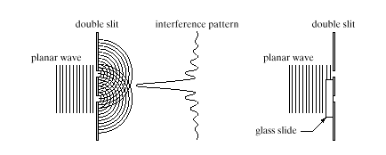
ConcepTest 24.5 Interference Pattern
pattern vanishes
pattern expands
bright and dark spots are interchanged
pattern shrinks
no change at all
An interference pattern is seen from two slits. Now cover one slit with glass, introducing a phase difference of 180° (1/2 wavelength) at the slits. How is the pattern altered?
Double slit Interference pattern
wave

Slide 57
ConcepTest 24.5 Interference Pattern
An interference pattern is seen from two slits. Now cover one slit with glass, introducing a phase difference of 180° (1/2 wavelength) at the slits. How is the pattern altered?
pattern vanishes
pattern expands
bright and dark spots are interchanged
pattern shrinks
no change at all
If the waves originating from the two slits have a phase difference of 180° when they start off, the central spot will now be dark !! To the left and the right, there will be bright spots. Thus, bright and dark spots are interchanged.
Double slit Interference pattern
wave
Follow-up: What happens when the phase difference is 90°?

